Slide 1
INSTRUCTIONS
Use Font size 22 to 28 and Font Style Times New Roman (body)
Do not change the Template: Heading / Title of the slides
Do not change font style or colours
Do not copy paste paragraphs: use only Bullet Points
Maximum slide Limit is 20 only
As per the number of supervisor allotted adopt slide-2 or slide-3
Please display the required meaningful Content or images or tables
Change the footer accordingly using insert tab then click on header & footer tab and edit it
Save the PPT with Register No, Dept and Review no, example: 23xxxxxxxxx_CSE

Slide 2

Title: Automated expense splitting and sharing
Student Name: B.Siri Manasa
Student ID: 2520030563
Cluster:1
Section: fwd-1,dsa-4
Under the Guidance
of
Supervisor Name: Ramakanth sir
Assistant Professor
Department of CSE

Slide 3
OUTLINE
Abstract
Existing System
Proposed System
System Architecture
Project Modules
Objectives
Co’s Attainments - FWD
Co1
Co2 …….. 5. Co5
Co’s Attainments - DSA
Co1
Co2 …….. 5. Co5
Screen Shots for FWD & DSA
Conclusion
Geo-Tagged Photos

Slide 4
Abstract
The Automated Expense Splitting and Sharing project is a web-based application designed to simplify the management of shared expenses among groups. When people travel, dine together, or share living expenses, calculating individual contributions manually can be difficult and time-consuming.
This project allows users to enter expenses, select participants, and automatically split the cost among them. The application uses web development technologies and basic data structures to store and process expense information efficiently.

Slide 5
Existing System
In the existing system, people usually track shared expenses manually using notebooks, calculators, or simple spreadsheets.
Each person must calculate the amount owed by every participant individually.
This method is time-consuming and prone to calculation errors.

Slide 6
Proposed System
Java console-based Automated expense splitting and sharing
Allows users to add, display, search, sort, and delete expense records
Uses ArrayList to store expense data and participant details. ArrayList can store expense amounts, user names, and transaction records.
.Implements Linear Search can be used for searching a participant and a specific expense record.
Uses Bubble sort to arrange expenses and sorting expenses from highest to lowest.
Uses Stack to undo the last expense entry
Uses Queue to process expenses in order and entered processed first(FIFO)
Uses HashMap to store and calculate each persons share.
Provides a faster and more organized way to manage shared expenses
Reduces manual calculation errors and improves expense tracking.
Helps understand the practical use of Data Structures and Algorithms

Slide 7
System Architecture
System architecture refers to the overall structure of a software application that shows how different components interact with each other to perform the required tasks.
Input: user enters details(date, number of persons)
Data storage: stored using arraylist
Processing: operations like add, sort, delete, search, display
Algorithms: uses linear search and bubble sort
Data structures: uses stack, queue, hash map for efficient handling
Output: displayed on the screen

Slide 8
Project Modules
. User Registration Module
Allows new users to create an account.
Stores user information securely.
2. Login Module
Users can log in with username and password.
Ensures secure access to the application.
3. Expense Entry Module
Users can add new expenses.
Enter details like:
Amount
Description
Participants
4. Expense Splitting Module
Automatically divides the total amount among members.
Shows each person’s share clearly.
5. Balance Tracking Module
Keeps track of who owes money and who should receive money.
Displays pending balances.
6. Settlement Module
Allows users to mark payments as settled.
Updates the balance status.

Slide 9
Objectives
To develop a web-based application that helps users easily split
To simplify expense calculation by automatically dividing the total bill amount, including GST or tax, among the involved persons.
To provide a user-friendly interface where users can enter expense details such as category, date, bill amount, and payer information.
To maintain a record of previous transactions so that users can view, edit, or delete past expenses when required.
To automatically calculate individual shares for each participant and display the payable amount clearly.
To store expense data securely using Local Storage, allowing the information to remain available even after refreshing or reopening the web page.
To generate a monthly expense summary that helps users track their total spending over time.
To demonstrate the application of HTML, CSS, and JavaScript concepts such as forms, responsive layouts, DOM manipulation, and data storage.

Slide 10
Co’s Attainments - DSA
C0 1: Apply basic data structures and abstract data typed(ADT) to organize and manage data efficiently.
CO 2: Implement searching algorithms such as linear search to find specific data in the system
CO3: Use sorting algorithms to arrange data in an organized order for easy access and readability
C04: Utilize list ADT or linked list concepts for sorting and managing dynamic data.
C05: Demonstrate understanding of stack and queue operations for handling data processing tasks.

Slide 11
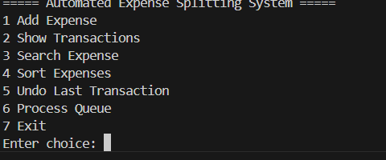
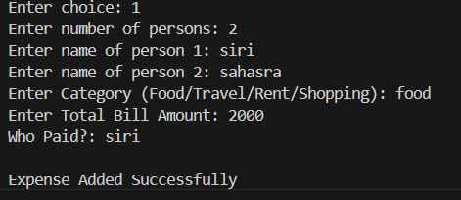
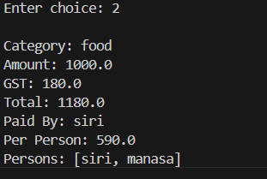
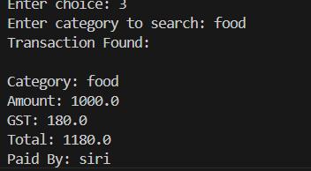

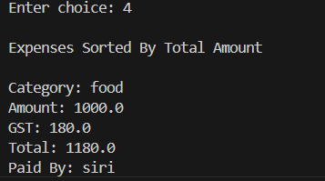
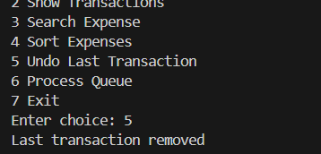
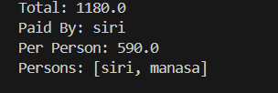
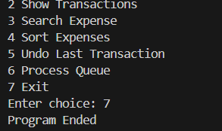
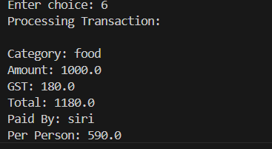

Screenshots for DSA

Slide 12
Conclusion
The Automated Expense Splitting and Sharing project simplifies group expense management.
It helps users split bills accurately and quickly.
The project reduces manual calculation errors and improves transparency among users.
It is useful for friends, roommates, travel groups, and event organizers.
Through this project, we learned web development concepts, expense calculation logic, and user interface design.

Slide 13
Geo- Tag Photos

Slide 14
THANK YOU

